Slide 1


Slide 2
APCOM HIV Prevention Initiatives
Midnight Poonkasetwattana
APCOM Executive Director
midnightp@apcom.org

Slide 3

MSM & HIV IN ASIA PACIFIC
MSM to account for more than half of the 300,000 new annual HIV cases that are forecast to occur in APAC by 2020
1 in 4 MSM in Ho Chi Minh, Jakarta, Kuala Lumpur and Yangon is HIV+ and 1 in 3 MSM in Bangkok is HIV+. MSM account for 90% of new HIV cases in Philippines
18 out of 38 countries in Asia and the Pacific criminalize same-sex sexual activities, with penalties including imprisonment, corporal punishment and even death
Low rates of consistent condom use with less than half of MSM in most major Asian cities using condoms inconsistently, a rate that is far too low to have an impact on reducing HIV transmission among MSM.

Slide 4

MSM & HIV IN ASIA PACIFIC
Over 50% of MSM in Asia Pacific don’t know their HIV status
HIV testing rates among MSM average around 50% across the region. Range from 11% in Bangladesh to 74% in Nepal.
Only 40% of MSM reached with HIV prevention programs in last 12 months across the region. Ranges from 4% in Laos to 70% in Myanmar.
PrEP is only available in Thailand, Vietnam, Singapore and Taiwan

Slide 5



TestBKK
Our TestBKK initiative is leading the way across the region in terms of raising awareness about HIV testing, treatment and prevention (including PrEP) among young MSM.
Now in its fifth year, the program uses culturally appropriate content to target young MSM in Bangkok through social media, online advertising and event-based initiatives. The initiative also includes an online booking system for local HIV testing clinic.

Slide 6


TestXXX
Through our TestXXX programme we collaborate with various HIV and MSM focused community organisations in Asian cities with high HIV prevalence to raise awareness about HIV testing, treatment and prevention among young MSM.
Modelled on our TestBKK initiative, our TestXXX partners also use social media, online advertising and event-based initiatives to promote information and content that’s appealing for young MSM.

Slide 7
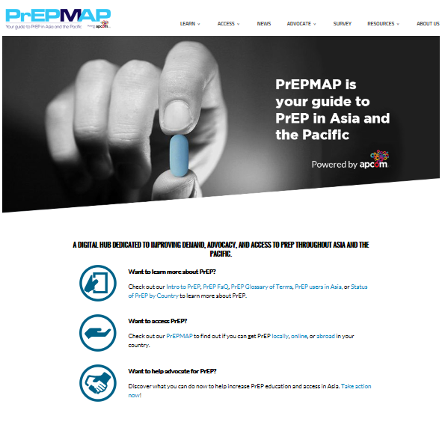
PrEP MAP
A new digital resource aimed at increasing awareness of HIV combination prevention and access to PrEP for people in Asia Pacific.
The web-based resource is a comprehensive guide to PrEP in Asia Pacific which houses the latest information about PrEP education and access in the region, and also as an advocacy for improved access to the drug.

Slide 8
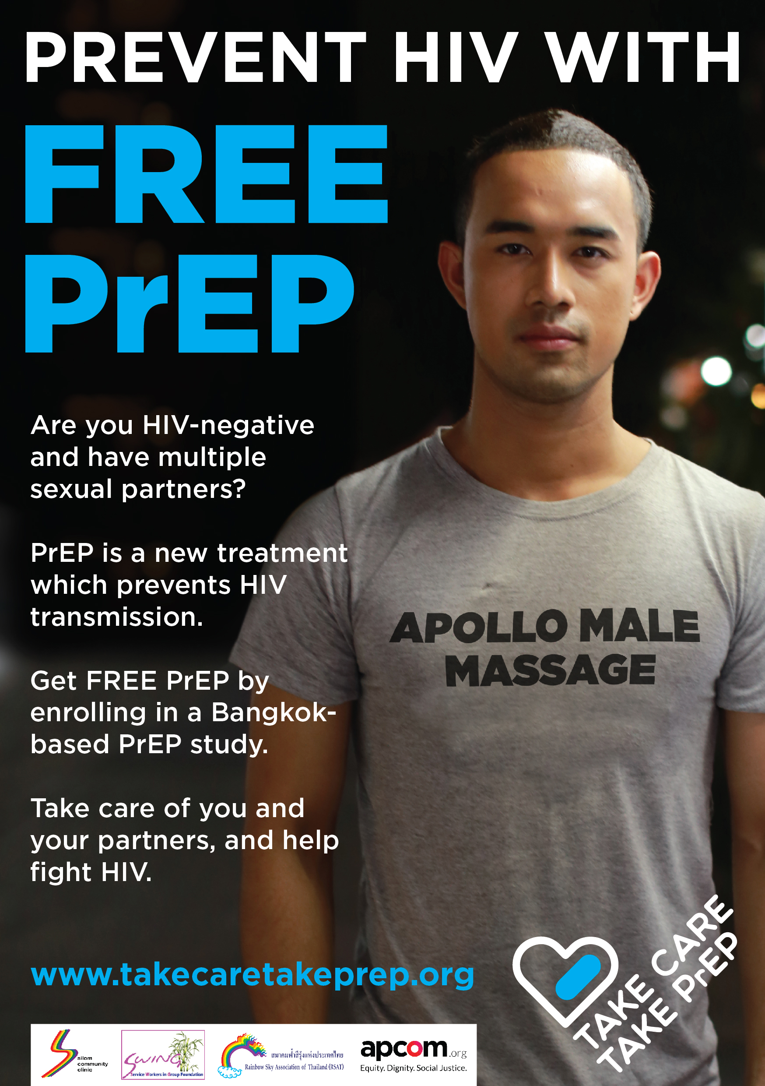
Take Care, Take PrEP
New campaign to recruit participants into a US-funded research trial aimed at evaluating the effectiveness of PrEP among young male and transgender sex workers in Bangkok.
Launches in Bangkok late Aug 2018
APCOM has produced online, dating app and venue based marketing materials + two videos

Slide 9

PULSE
Community research, advocacy and capacity building project to improve HIV services for young MSM in the greater Mekong region of Southeast Asia by improving the quality of epidemiological and behavioural data about young MSM.
The centerpiece of the initiative is three on-line surveys over three years which APCOM will oversee in partnership with community organisations, researchers and health authorities in Cambodia, Myanmar, Laos, Thailand and Vietnam.

Slide 10
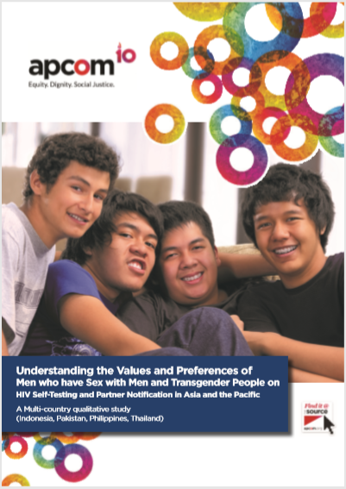
HIV SELF-TESTING
Research study about understanding the values and preferences of MSM and transgender people on HIV self-testing in Asia Pacific.
Qualitative study conducted in Indonesia, Pakistan, Philippines, Thailand
Found high interest among MSM in having HIVST made available but a range of barriers regulatory and costs barriers to overcome.

